Slide 1
TRAIN DELAY PREDICTION USING MACHINE LEARNING

Slide 2
Abstract
The Train Delay Prediction System utilizes machine learning algorithms like Linear Regression and Decision Trees to accurately forecast train delays by analyzing historical data, weather conditions, and operational factors. By integrating Python for model development and React with Tailwind CSS for the frontend, the system delivers reliable predictions and a seamless user interface. This solution addresses a critical transportation challenge, empowering passengers with accurate updates and aiding railway operators in resource optimization, enhancing overall efficiency and reliability.

Slide 3
Introduction
Train delays significantly impact passenger satisfaction, economic efficiency, and logistics operations. Traditional systems rely on reactive measures, which fail to address delays proactively. This project, "Train Delay Prediction Using Machine Learning," leverages historical and real-time data to forecast delays with high accuracy. By analyzing key factors such as weather, infrastructure, and operational data, the system enables railway operators to minimize disruptions. This predictive approach enhances reliability, improves passenger experiences, and supports efficient railway operations.

Slide 4
Existing System
The existing railway management systems primarily rely on reactive approaches to handle train delays, which involve addressing disruptions only after they occur. These systems use static schedules and lack advanced predictive capabilities, making it difficult to anticipate delays caused by weather, infrastructure issues, or operational inefficiencies.
Communication with passengers regarding delays is often inadequate, leading to dissatisfaction. Additionally, resource allocation is inefficient, as decisions are made without real-time insights. This reactive nature results in frequent delays, economic losses, and decreased system reliability.

Slide 5
Proposed System
The proposed system introduces a Machine Learning-based Train Delay Prediction model that proactively identifies potential delays using historical and real-time data. By analyzing factors such as weather conditions, train schedules, operational data, and infrastructure status, the system provides accurate delay forecasts. This allows railway operators to make informed decisions, optimize scheduling, and allocate resources efficiently.
Real-time dashboards display delay predictions, enabling timely communication with passengers and minimizing disruptions. The system enhances reliability, reduces economic losses, and improves passenger satisfaction by transitioning railway operations from a reactive to a predictive approach.

Slide 6
LITERATURE REVIEW
Several studies highlight the use of machine learning techniques in transportation systems to predict and mitigate delays. Research has demonstrated the effectiveness of algorithms like Random Forest, Gradient Boosting, and Neural Networks in analyzing factors such as weather, historical delays, and infrastructure conditions.
Traditional statistical models often fall short in capturing complex patterns, whereas machine learning models offer higher accuracy and adaptability. Existing systems emphasize reactive approaches, but recent advancements advocate for predictive analytics to enhance operational efficiency. This project builds on these insights to develop a robust train delay prediction system.

Slide 7
Module
1. Libraries
Pandas: For data manipulation and preprocessing.
NumPy: For numerical operations and handling arrays.
Scikit-learn: For implementing machine learning algorithms and evaluation metrics.
Matplotlib/Seaborn: For visualizing data and model performance.
Joblib: For saving and loading the trained model.
Datetime: For handling time-related features.
Flask/Django: For building the web-based interface.
APIs: For integrating real-time weather or train status data.

Slide 8
2. Algorithms
Random Forest Regressor: For robust, ensemble-based delay predictions.
Gradient Boosting Machines (GBM): For high-accuracy predictions in complex datasets.
Support Vector Machines (SVM): For delay classification and regression tasks.
Neural Networks: For learning nonlinear relationships in large datasets.
Linear Regression: For baseline predictions and comparison.
K-Means Clustering (Optional): For grouping similar delay patterns.

Slide 9
3. Feature Engineering
Label Encoding: To convert categorical data (e.g., train type, weather) into numeric format.
Datetime Features: Extracting hour, day, and month from time data.
Scaling and Normalization: To prepare data for certain algorithms.
4. Evaluation Metrics
Mean Absolute Error (MAE): To measure prediction accuracy.
Root Mean Square Error (RMSE): For assessing the model's performance.
R² Score: To evaluate how well the model explains variability.

Slide 10
Software Components:
1.Matplotli
2.NumPy
3. Scikit-learn
4. Flask
5. Joblib
Hardware Components:
1.GPU (Graphics Processing Unit)
CPU (Central Processing Unit)
RAM (Random Access Memory)
Storage
Edge Device (Optional)
Power Supply

Slide 11
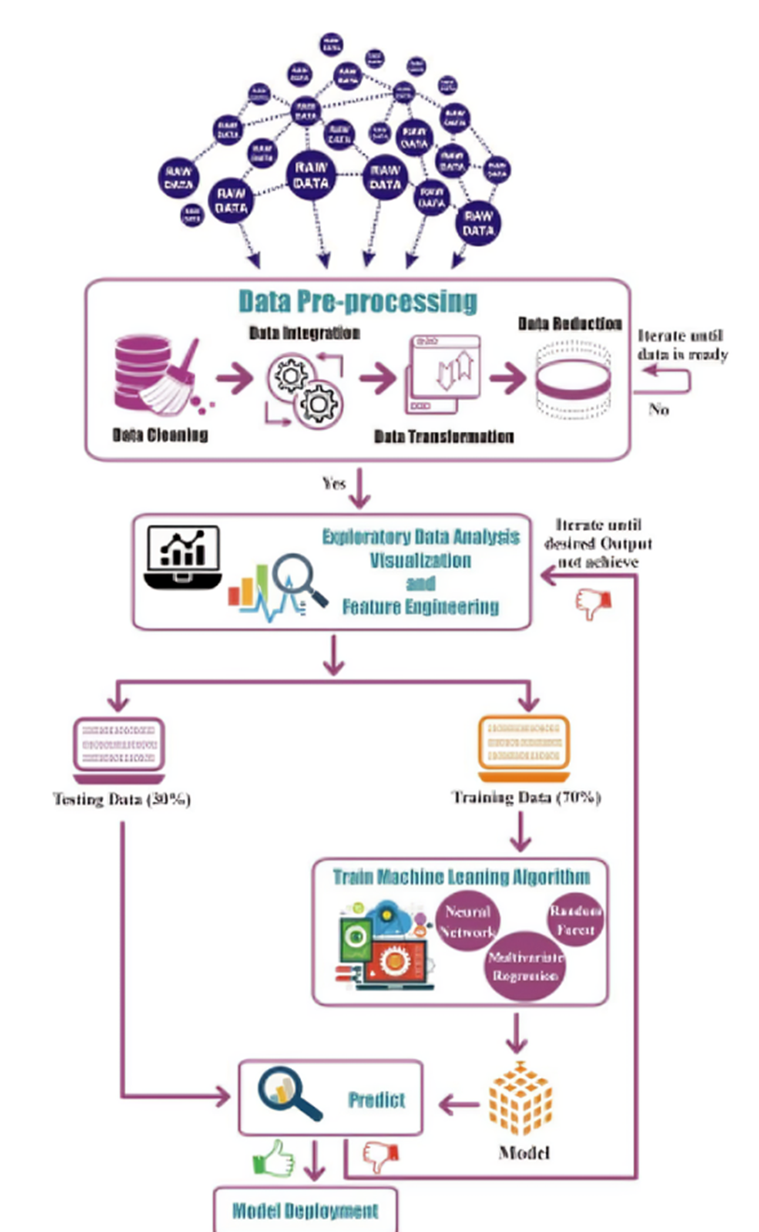
Block Diagram

Slide 12
UML Diagrams
Use Case Diagram
Data Flow Diagram
Sequence Diagram
State Diagram

Slide 13
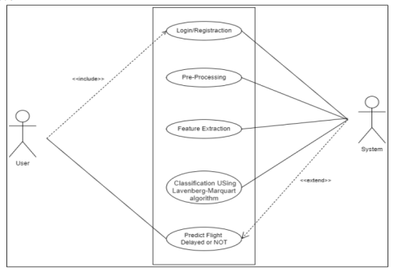
Usecase Diagrams

Slide 14
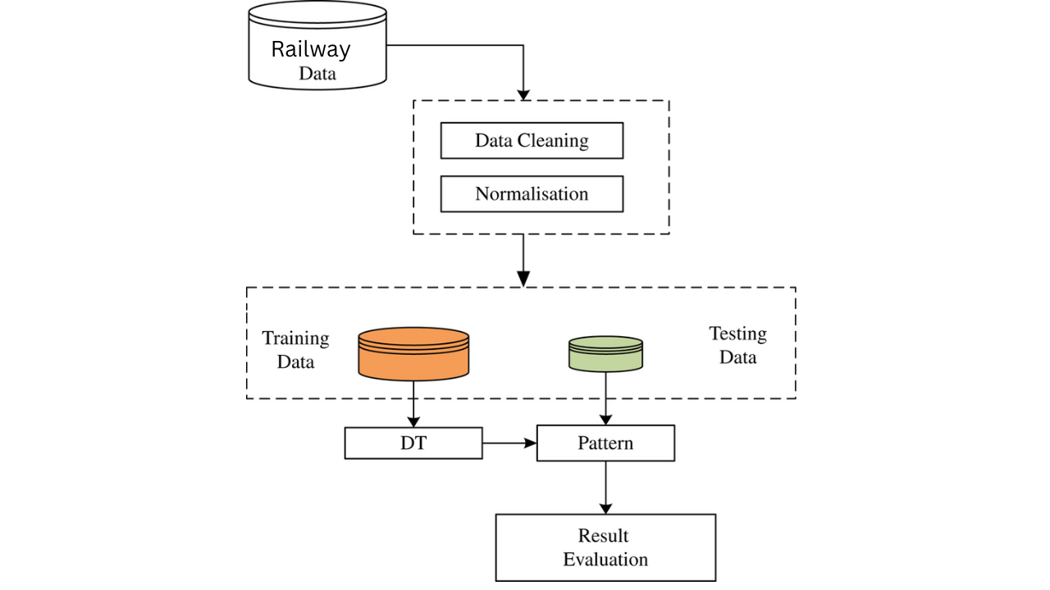
Data Flow Diagrams

Slide 15
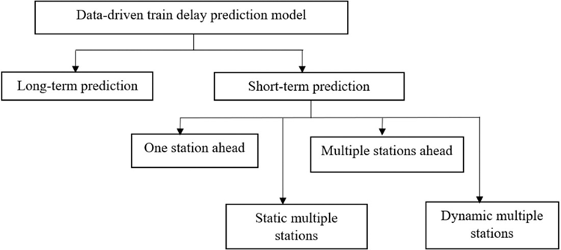
Sequance Diagrams

Slide 16
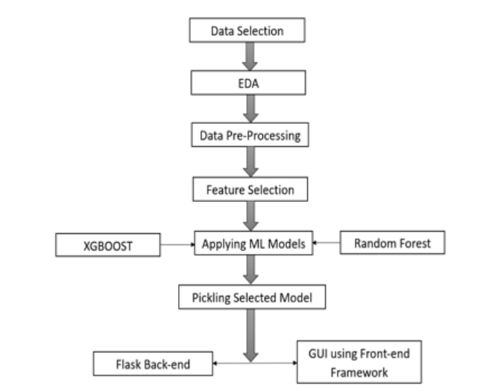
Active Diagrams

Slide 17
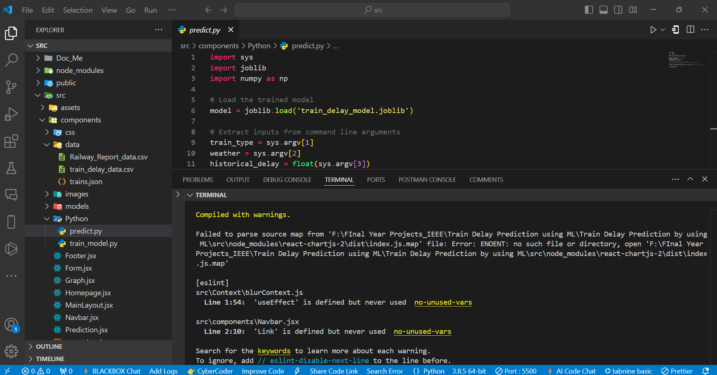
Final Output
This section presents the results obtained from various machine learning models developed for predicting train delays. The analysis focuses on the performance of each model, comparing their accuracy, and identifying the best approach for this predictive task.

Slide 18
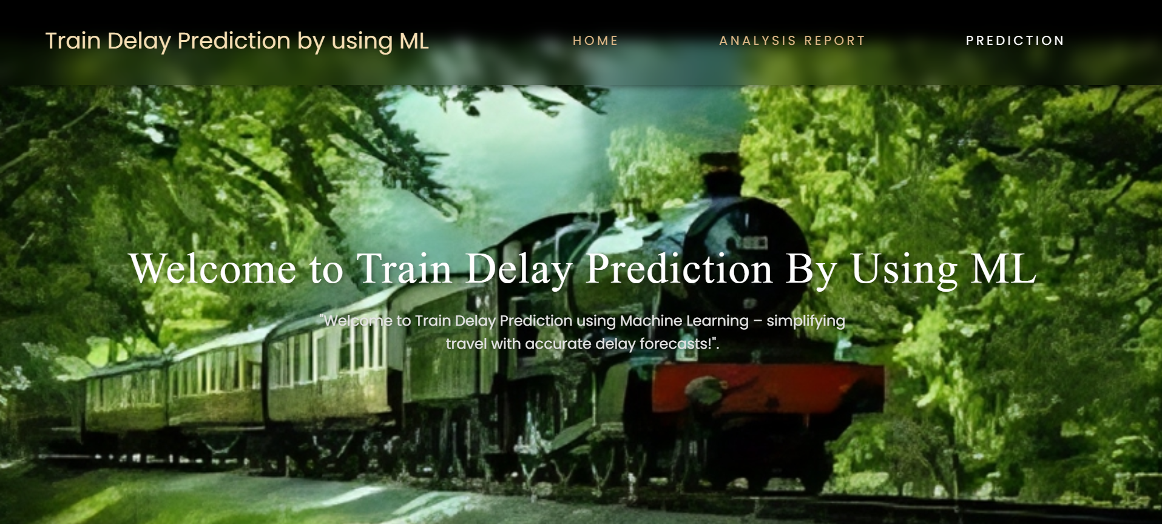
Final Output
Ui Framework Home Page

Slide 19
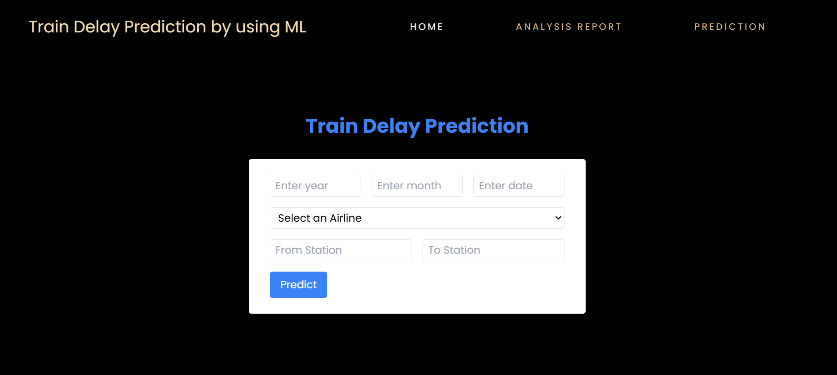
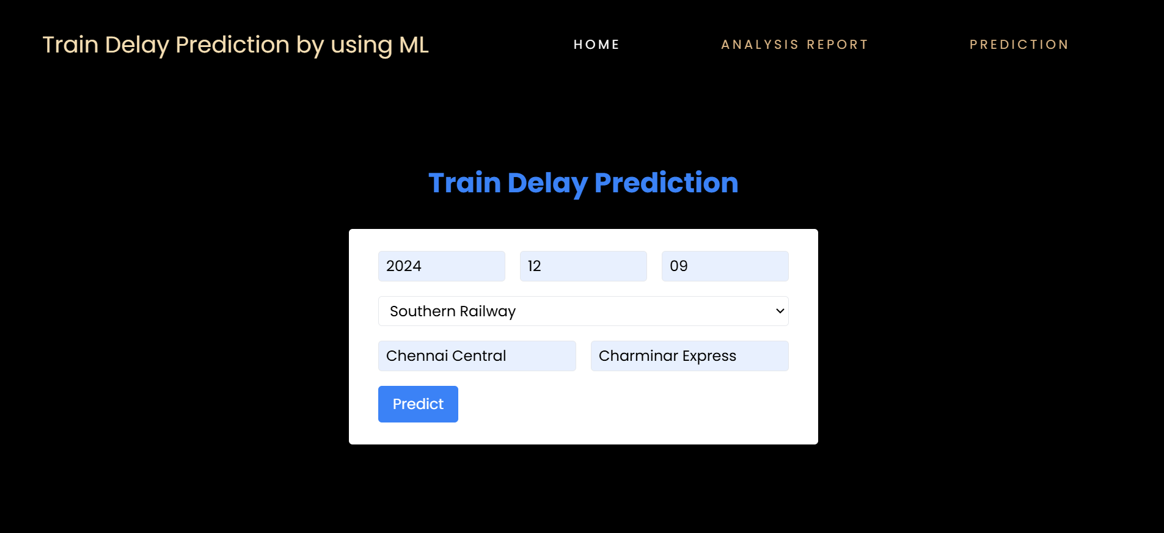
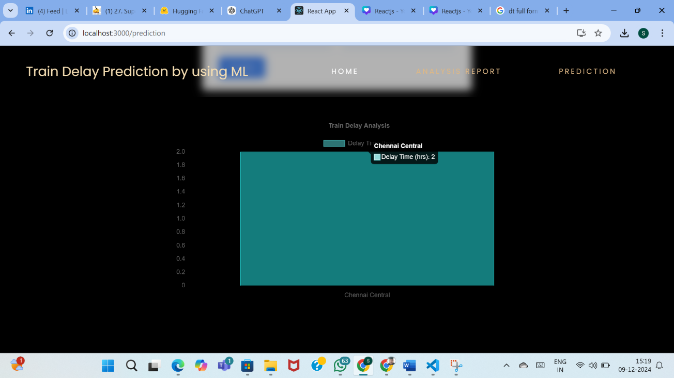
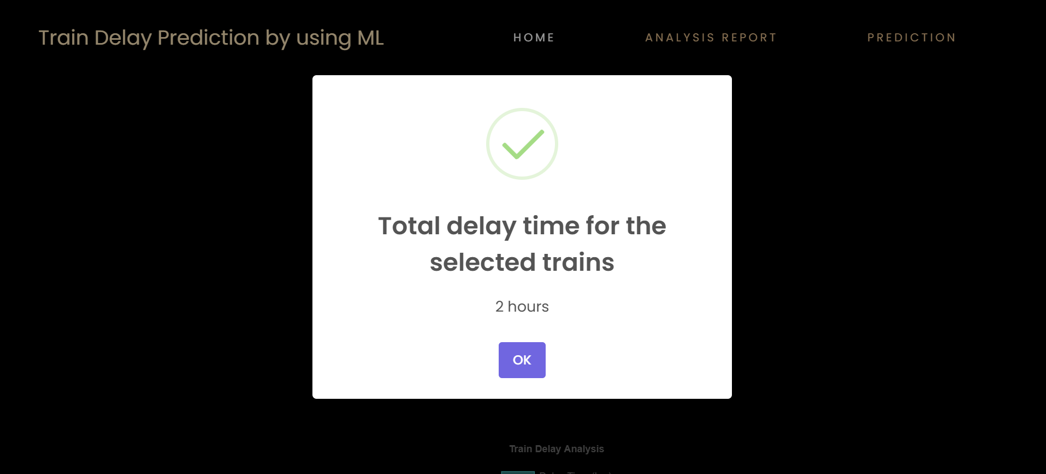
Final Output
Predicting the train delay data

Slide 20
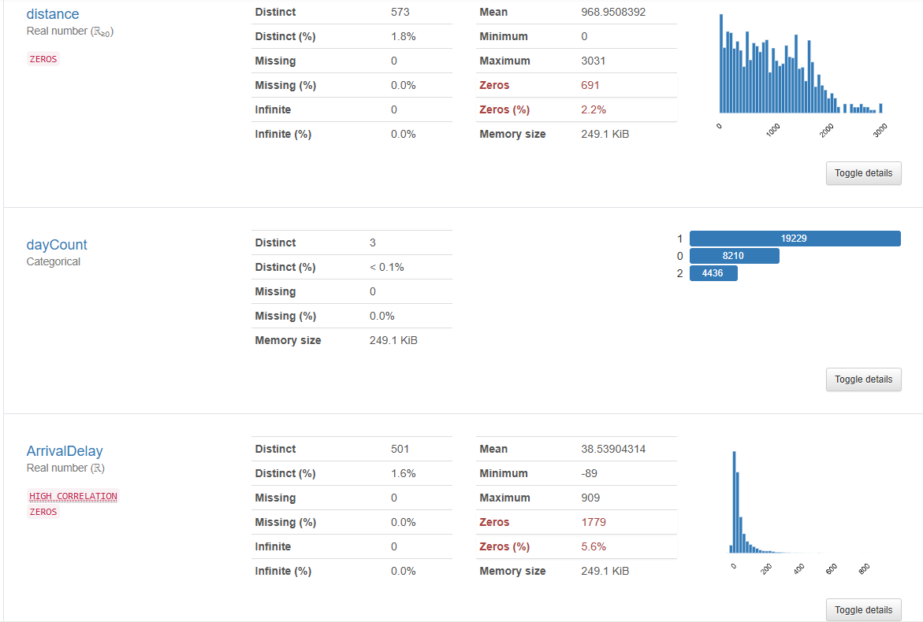
Final Output
Analysis Report

Slide 21
Conclusion
The Train Delay Prediction System utilizing machine learning offers a proactive solution to the persistent problem of train delays. By analyzing historical and real-time data, the system can accurately predict delays, allowing operators to optimize schedules and resources. This approach not only enhances operational efficiency but also improves passenger satisfaction by providing timely updates. The integration of advanced algorithms ensures high prediction accuracy and scalability. Ultimately, this system paves the way for smarter, more reliable railway operations, reducing costs and enhancing service quality.

